Slide 1
Sports Info Solutions’ 2020 Football Analytics Challenge
Benefitting the United Negro College Fund
Daniel Rees
July 19, 2020

Slide 2
Questions to be Addressed
Which is the most valuable defensive line position?
How do we define “defensive line position”?
How do we define “value”?
What is the distribution of talent at each defensive line position?
Talent measured by player opportunity
Talent measured by player performance
What scenarios would impact defensive line position value?
Win probability of defensive team
Base defense of defensive team

Slide 3
Data Sources
SIS Database
Excluded Roster Position = “Off Ball”
nflscrapR
Used R coding provided to model Expected Points and Win Probability.
https://github.com/maksimhorowitz/nflscrapR
The IDP Guru
Base Package determination for 2019 for all teams.
These were not deemed to represent “defensive line” snaps.
Excluded QB Spikes (Spike = 1)
These were not deemed to be meaningful snaps.
Used R coding to determine expected yards gained for possible outcome determination.

Slide 4
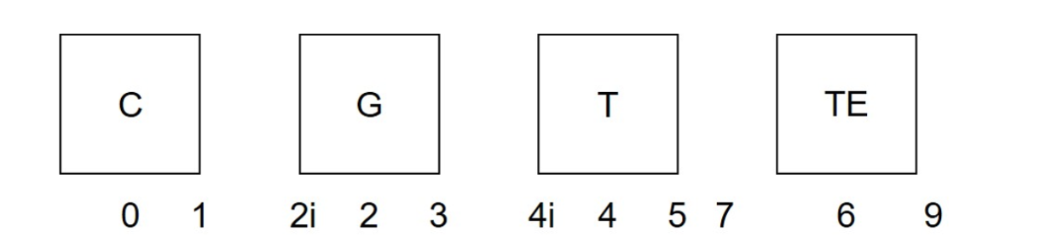
Terminology: DL Technique
Throughout the presentation, we will refer to the “technique” to the alignment used by the defensive linemen.
The technique is defined based on positioning relative to offensive linemen.
The chart below shows the different types of defensive line techniques:
Outside
Notes:
Throughout the presentation, we will be referring to the Technique. As many of you know, the DL Technique describes the alignment of the DL relatively to the offensive line. Above is a graphical representation of those alignments.

Slide 5
Which is the most valuable defensive line position?
How do we define “defensive line position”?
Define possible approaches
Review each approach
How do we define “value”?
Define possible approaches
Review each approach

Slide 6
How do we define “defensive line position”?
Possible approaches:
Roster Position
Possible value: DE, DT, LB, other
Value set by team
On Field Position
Possible values: DL, LB
Too broad of categories to gain significant insight
Technique Position
Possible values: 0, 1, 2i, 2, 3, 4i, 4, 5, 7, 6, 9, outside
Large number of possible values
Players with positions can play wide range of techniques

Slide 7
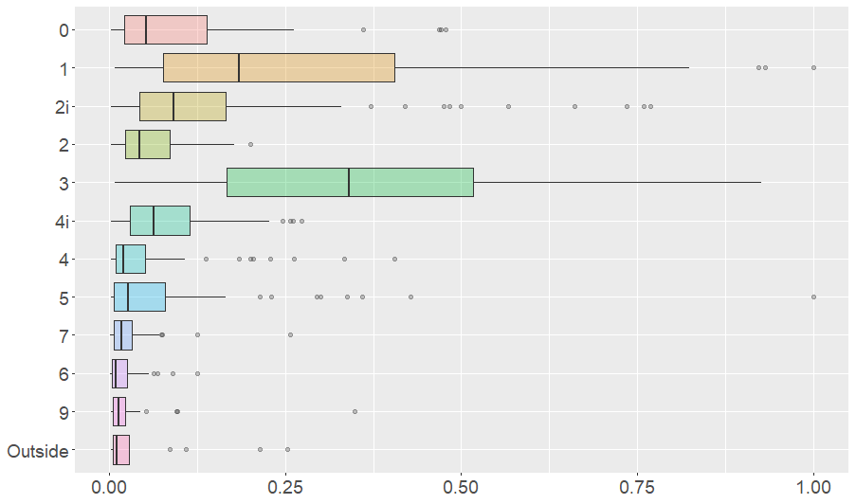
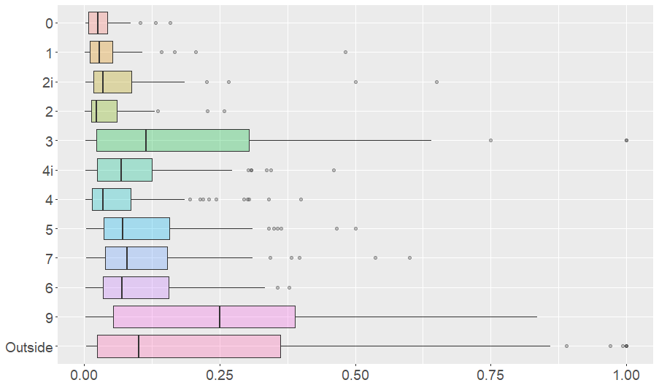
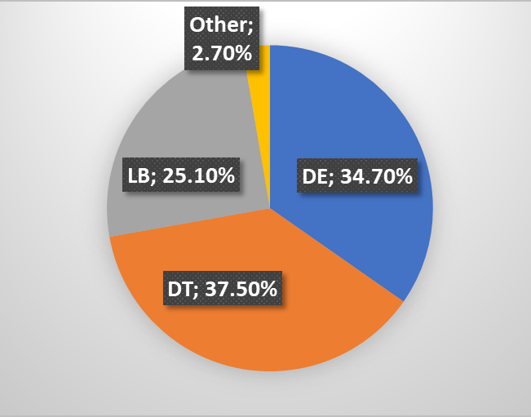
How do we define “defensive line position”?
Roster Position
Possible value: DE, DT, LB, other
Value set by team
Players with positions can play wide range of techniques
Conclusion
Since roster position does not have consistent meaning across players/teams, this could lead to inconsistent results so we will not use the roster position definition for this analysis.

Slide 8
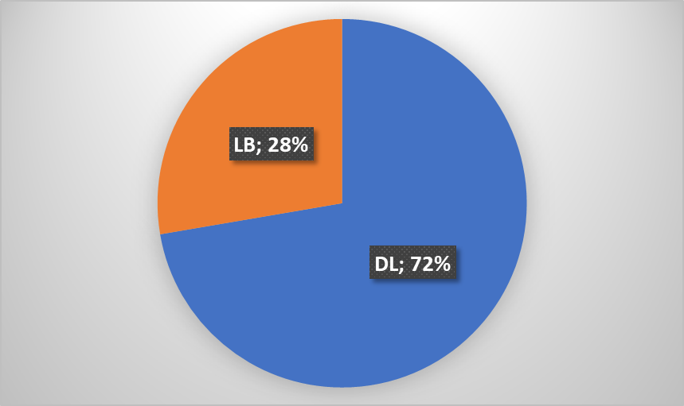
How do we define “defensive line position”?
On Field Position
Possible values: DL, LB
Too broad of categories to gain significant insight
Outside
Conclusion
On field position has too broad of categories to gain significant insight into the “value” of the defensive line position. As such, we will not use the on field position definition for this analysis.

Slide 9
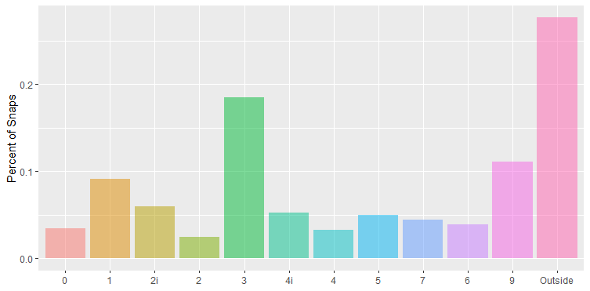
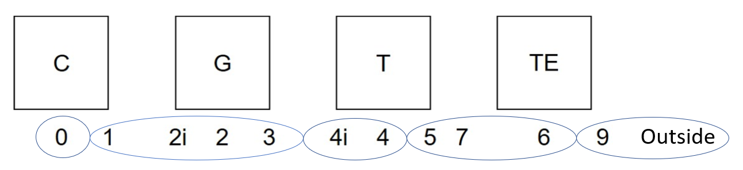
How do we define “defensive line position”?
Technique Position
Possible values: 0, 1, 2i, 2, 3, 4i, 4, 5, 7, 6, 9, outside
Large number of possible values
Conclusion
Since the technique position definition is consistent across all teams and the position provides enough detail, the technique position will be the starting point for the “defensive line position” definition used in this analysis.
Due to the large number of possible values, the technique position will be grouped based on consistent field positioning and analysis results.

Slide 10
How do we define “defensive line position”?
Technique Grouping:
Twelve unique technique alignments likely would make it very difficult to arrive at meaningful conclusions.
In order to allow for more manageable analysis, technique alignments will be grouped.
These groupings will be based on similar alignments to ensure conclusions can be consistently applies.
These groupings will also be based on similar results in order to ensure additional information is not lost during the analysis.
Outside

Slide 11
How do we define “value”?
Possible approaches:
Results Based
By looking at results to determine the value of the position, we determine the value of the players that are currently at the position.
Opportunity Based
This measures the value of the players instead of the position.
Expected Points Added Range (EPAR)
Win Probability Added Range (WPAR)
By looking at the potential value based on the opportunities given to the players at the position, we can isolate the value of the position from the quality of the players at that position.
Value of these opportunities will be reviewed based on:

Slide 12
How do we define “value”?
Opportunity Based: EPA / WPA
Expected Point (EP) and Win Probability (WP) based on model developed by NFLScrapR Team.
Starting EP/WP
Determined based on status information at the beginning of each play provided in the SIS data
Ending EP/WP
Determined using status information based on play results information provided in the SIS data
EP Added (EPA) WP Added (WPA)
Difference between the Starting EP/WP and the Ending EP/WP

Slide 13
How do we define “value”?
Opportunity Based: EPAR / WPAR
For each snap, there is a range of possible events, each with a likelihood of occurring.
EPA & WPA Ranges (EPAR & WPAR) measures the spread between possible outcomes.
For this purpose, we will use four possible outcomes.
Spread calculated based on standard deviation.
Higher EPAR/WPAR indicates a play with a range of outcomes which results have high spread of possible EPA/WPA.
For example:
3rd and 5 would have a large EPAR since the range of outcomes have a wide range of possible EPA/WPA.

Slide 14
How do we define “value”?
Opportunity Based: Range of Outcomes
Four possible outcomes were determined for the EPAR calculation.
Outcomes based on “expected yards gained” which was calculated based on quartiles of recent historical results.
Based on:
Data from all plays from 2015 – 2019
Plays were grouped by down, yards to go, and yard line (in 10 yards increments)
Similar small data group were grouped together to have a more reasonable size of results
12.5th, 37.5th, 62.5th, and 87.5th percentiles of yards gained for each data group were calculated

Slide 15
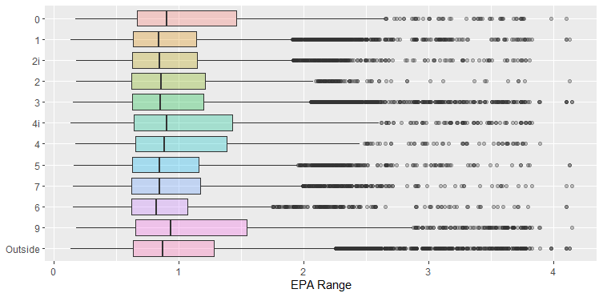
Most “valuable” defensive line position
Opportunity Based by Techniques
Initial review reveals apparent differences by technique
Techniques were grouped based on alignment & results:
NT (0 Tech)
DT (1, 2i, 2, 3)
DE (4i, 4)
DE Wide (5, 7, 6)
Outside (9, Outside)
Review of EPAR & WPAR showed similar results

Slide 16
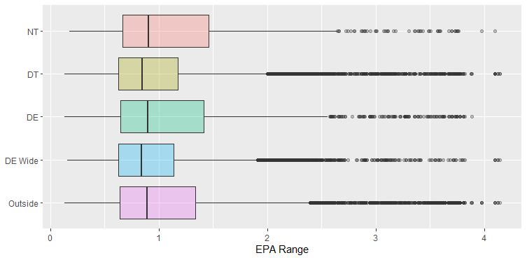
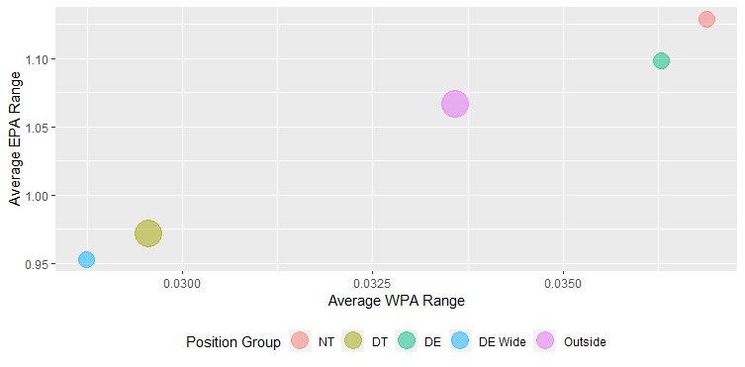
Most “valuable” defensive line position
Opportunity Based by Technique Groups: Per Snap Basis
EPAR & WPAR calculated for each snap and reviewed by technique group.
NT has highest average EPAR & WPAR.
Conclusions
DT & DE have lowest average EPAR & WPAR.
DE close 2nd, Outside 3rd
NT, DE, & Outside have wide distribution of EPARs with a larger upside in value.
DT & DE have smaller distribution of EPA/WPA ranges as well.

Slide 17
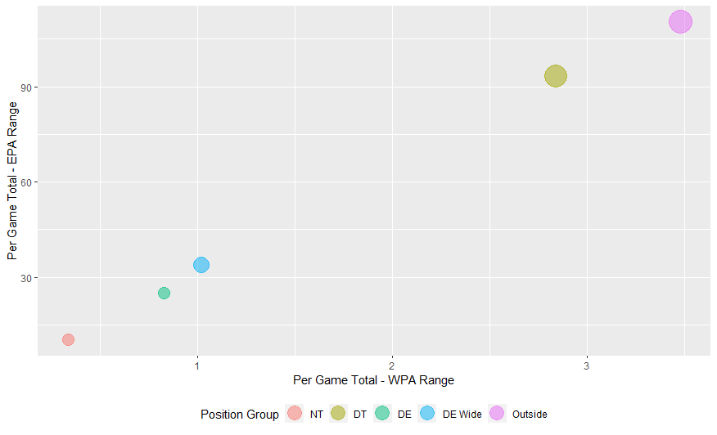
Most “valuable” Defensive Line Position
Opportunity Based by Technique Groups: Per Game Basis
EPAR & WPAR on a Per Game Basis reviewed by DL Position.
Very limited number of snaps per game drops NT to lowest on a per game basis.
Conclusions
High number of snaps per game increases DT value significantly, bringing it to 2nd despite ranking 4th on a per game basis.
Combination of high number of snaps and high value per snap makes Outside DL the most valuable position on a per game basis.
Outside ranked 1st, followed by DT
DE Wide, DT, and NT significantly lower EPAR/WPAR on a per game basis than Outside and DT

Slide 18
Most “valuable” defensive line position
Summary
Value determined based on “opportunity” to impact game.
Measured by EPAR and WPAR
Position reviewed based on Technique groups (NT, DT, DE, DE Wide, Outside).
Per play basis:
NT
DE
Outside
DT
DE Wide
Per game basis:
Outside
DT
DE Wide
DE
NT
Value per game can be impacted by # of players at that position.
(e.g. two Outside DL, but only one NT)
Value can be impacted based on frequency if use based on defensive alignment.
(e.g. Base package of 3-4 or 4-3)

Slide 19
Distribution of talent by DL position?
Talent measured by player opportunity
Measured “value” based on the opportunity given
This approach was previously applied to the DL positions, but can also be applied to individual players.
Talent measured by player performance
Performance will be measured separately for pass and run plays.
Talent for pass plays measured based on number of events “impact on EPA”.
Used to determine what players are viewed as most “valuable” by the coaching staff.
Talent for run plays measured based on EPA for running plays that the defender is “involved”.

Slide 20
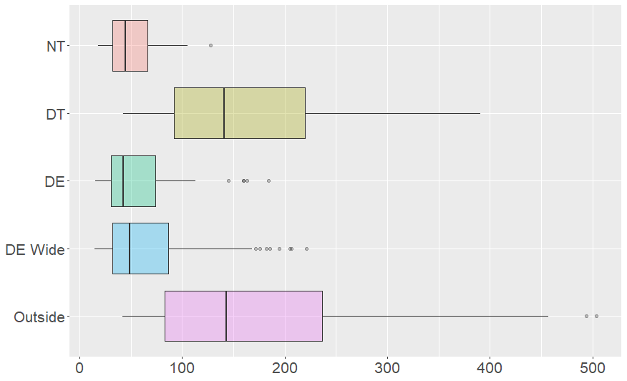
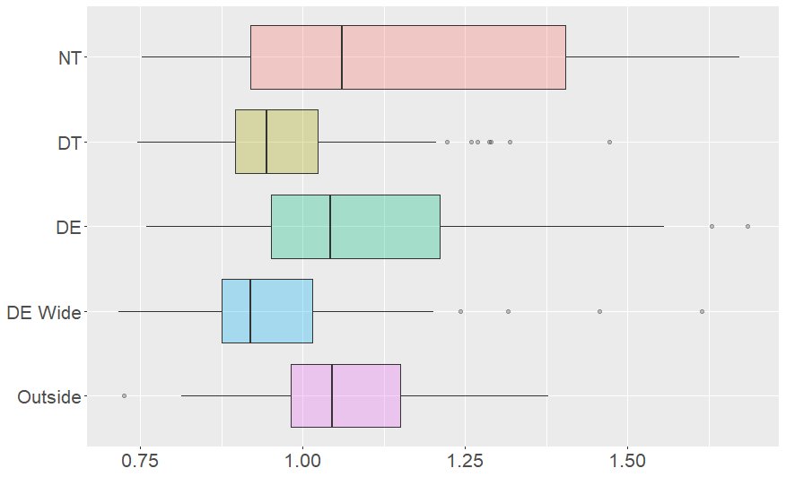
Distribution of talent by DL position?
Distribution of opportunity by DL Position
Players reviewed from both a total and per snap basis.
Totals are based on player’s snaps in technique group, so player could be listed multiple times (e.g. DE & Outside).
EPA Range Totals
By Player
EPA Range Per Snap By Player
Outside DL & DTs are given significantly more opportunity to impact the game based on total EPAR/WPAR.
DT’s Total EPAR is driven primarily by a large number of snaps.
18 out of top 20 by total EPAR are Outside DL.
The other 2 are DTs.
We’ll be primarily focusing on EPAR Totals since these capture the full value of the players more clearly.

Slide 21
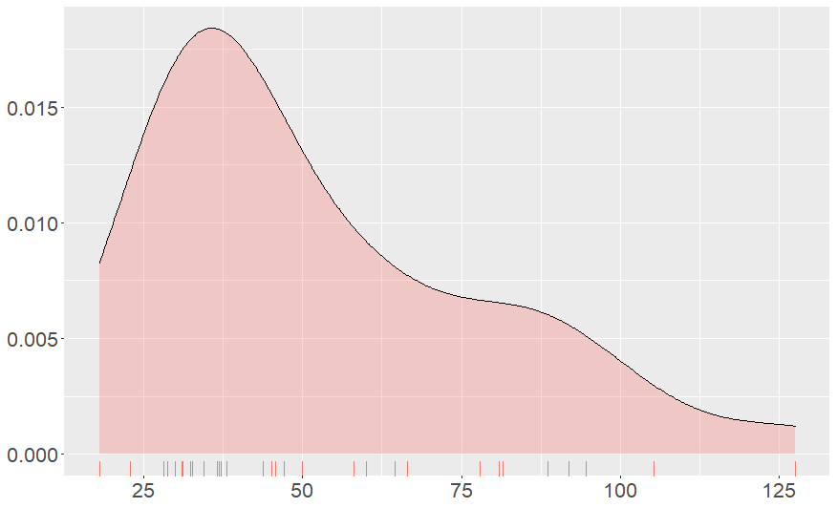
Distribution of talent by DL position?
Distribution of opportunity: Nose Tackle (NT)
Highest NT by Total EPAR
Damon Harrison (128)
2nd highest – Danny Shelton (105)
NT Tech Group averaged 49 snaps in SIS Data
Highest EPAR per snap
Dre’Mont Jones – 1.67
56% of eligible NTs had EPAR per snap over 1.0 (19 out of 34)
Nose Tackle
EPA Range Totals
Players must have at least 20 snaps at NT Tech to be included

Slide 22
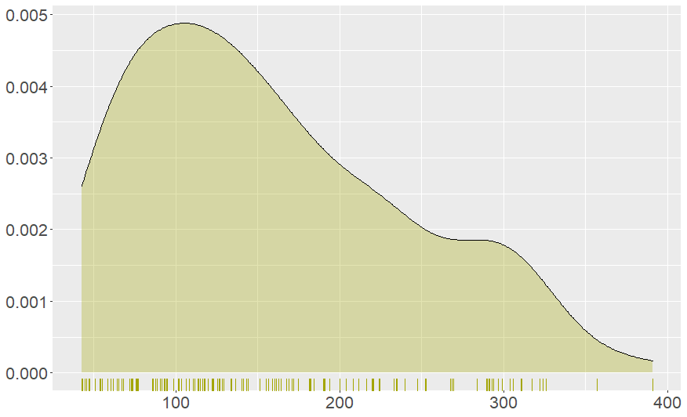
Distribution of talent by DL position?
Distribution of opportunity: Defensive Tackle (DT)
Highest DT by Total EPAR – DeForest Buckner (391)
2nd – Geno Atkins (357)
3rd – Larry Ogunjobi (326)
DT Tech Group averaged 164 snaps in SIS Data
Highest EPAR per snap
Ifeadi Odenigbo – 1.47
Only 31% of eligible DTs had EPAR per snap over 1.0 (46 out of 147)
Defensive Tackle
EPA Range Totals
Players must have at least 50 snaps at DT Tech to be included

Slide 23
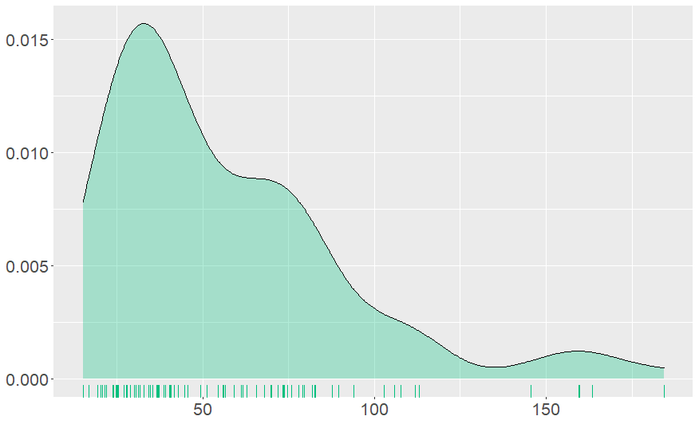
Distribution of talent by DL position?
Distribution of opportunity: Defensive End (DE)
Top DE by Total EPAR – Denico Autry (184)
Played 154 snaps at DE in SIS Data
Only 4 players w/ over 150 snaps (5th = 116)
2nd through 5th are above 145
After top 5, EPAR drops to 113 and under.
DE Tech averaged 51 snaps in SIS Data
Highest EPAR per snap
DeForest Buckner – 1.69
Normal considered DT, but qualified as DT and DE
EPAR per snap at DT – 1.00
64% of eligible DEs had EPAR per snap over 1.0 (63 out of 99)
Defensive End
EPA Range Totals
Players must have at least 20 snaps at DE Tech to be included

Slide 24
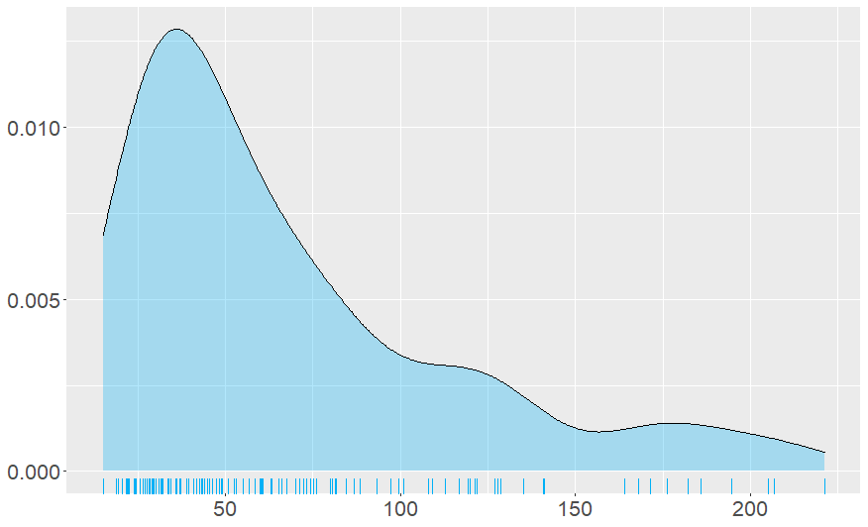
Distribution of talent by DL position?
Distribution of opportunity: Defensive End Wide (DE Wide)
Highest DE Wide by Total EPAR Danielle Hunter (221)
DE Wide Tech Group averaged 72 snaps in SIS Data
Highest EPAR per snap
Aaron Donald – 1.61
Normal considered DT, but qualified as DT, DE, and DE Wide
Highest EPAR per snap was at DE Wide
DT – 0.98
DE – 1.49
Only 28% of eligible DE Wide DL had EPAR per snap over 1.0 (34 out of 120)
DE Wide
EPA Range Totals
Players must have at least 20 snaps at DE Wide Tech to be included

Slide 25
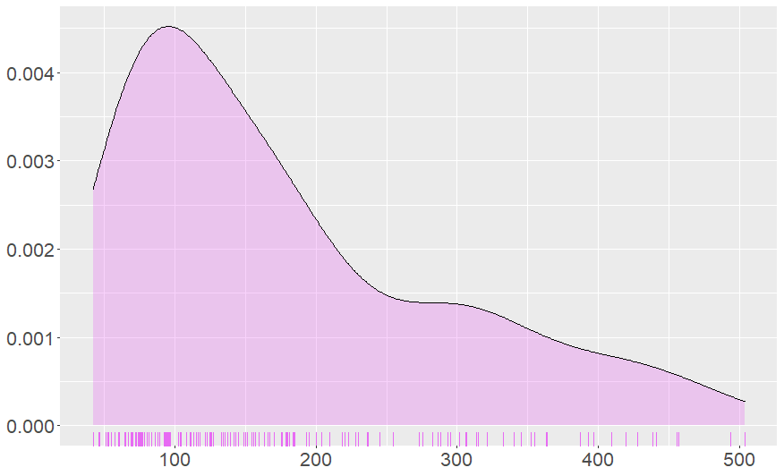
Distribution of talent by DL position?
Distribution of opportunity: Outside
Highest Outside DL by Total EPAR
Chandler Jones (504)
2nd highest Total EPAR
Bud Dupree (594)
After 2nd, Total EPAR drops down to 457
Outside Tech Group averaged 168 snaps in SIS Data
Highest EPAR per snap
Danielle Hunter – 1.38
70% of eligible Outside DL had EPAR per snap over 1.0 (99 out of 141)
Outside EPA Range Totals
Players must have at least 50 snaps at Outside Tech to be included

Slide 26
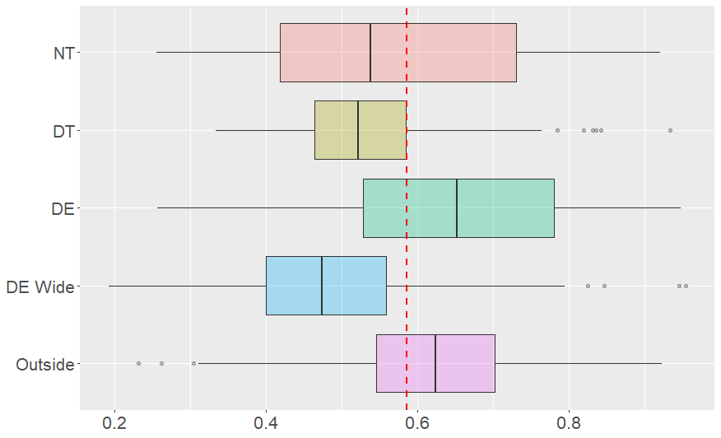
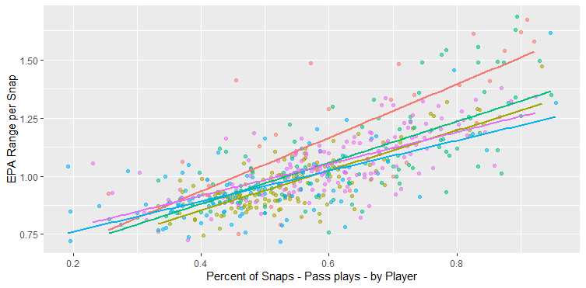
Distribution of talent by DL position?
Talent measured by player performance
Percent of Snaps: Pass Plays By Player
Performance is based on player’s snaps in technique group, so player could be listed multiple times (e.g. DE & Outside).
Performance will be measured separately for pass and rush plays.
DE & Outside DL generally play a higher than average number of pass plays.
Red line indicates the average % of snaps that are pass snaps based on SIS data.
Higher % of snaps that are pass plays correlates with higher EPA Range per snap.
Offenses are more likely to pass on highly variable downs.

Slide 27
Distribution of talent by DL position?
Talent measured by player performance: pass plays
Impact on plays measured by reviewing the Expected Points Added (EPA) provided in the SIS data for each defensive snap.
Impact was reviewed based on events from a defensive lineman that could impact a pass play:
Pressure
Sack (assisted or solo)
Pass breakup
Interception
Fumble by passer
Initially each event was reviewed to determine if there was an impact on EPA.
After review, linear regression was used to determine the estimated impact of each type of event on the EPA.

Slide 28
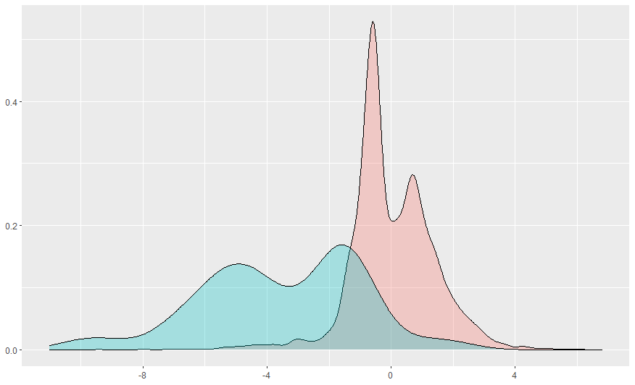
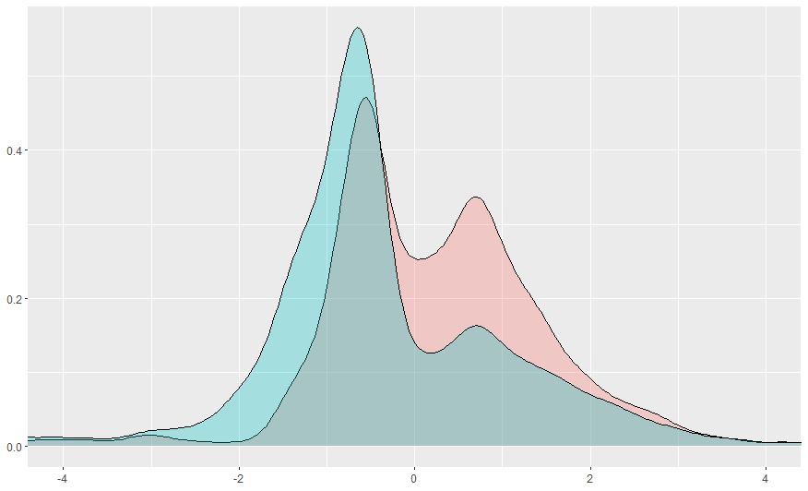
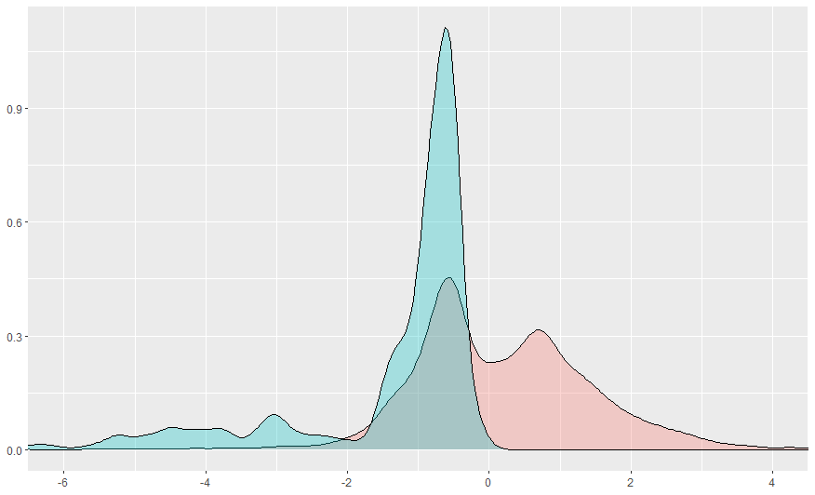
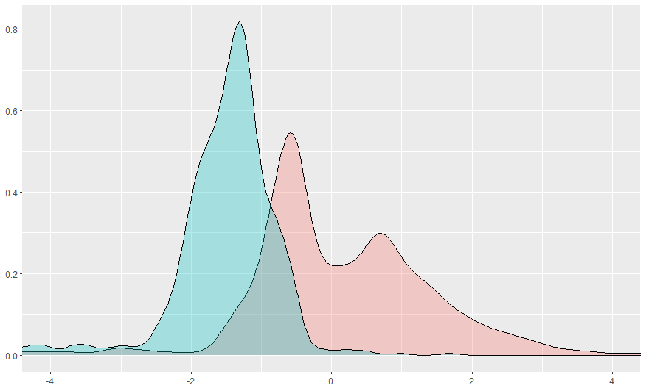
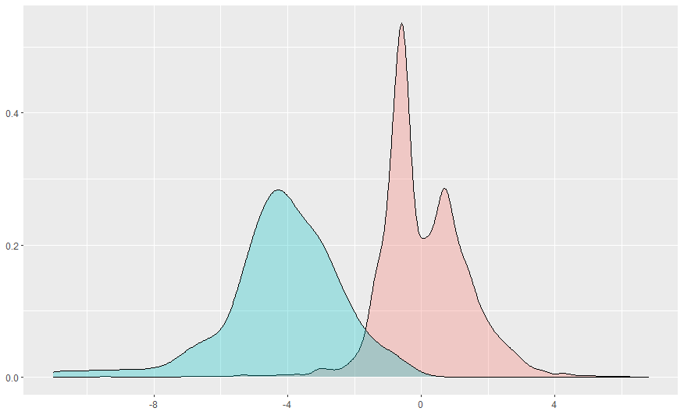
Distribution of talent by DL position? Talent measured by player performance on pass plays: Impact on EPA
Fumble by Passer
Pressure on Play
Pass Breakup on Play
All event types were determined to have an impact on the EPA distribution.
Therefore all event types were included in the linear regression model to determine Impact on EPA.
Interception on Play
Sack on Play

Slide 29
Distribution of talent by DL position?
Player performance on pass plays: Impact on EPA by Event
The impact of events on expected EPA by running a linear regression based on the SIS data.
No Event
Expected EPA for plays without an “event” is 0.405.
Represented by intercept of linear regression model.
Pressure
A pressure on a play is expected to drop the EPA by 0.254.
Sack
A sack on a play is expected to drop the EPA by 1.58.
This impact is in addition to the impact of a pressure.
Pass Breakup
A pass breakup on a play is expected to drop the EPA by 1.18.
Interception
An interception on a play is expected to drop the EPA by 3.27.
Fumble by Passer
A fumble by the pass is expected to drop the EPA by 2.18.
This impact is in addition the impact of a pressure and/or sack.

Slide 30
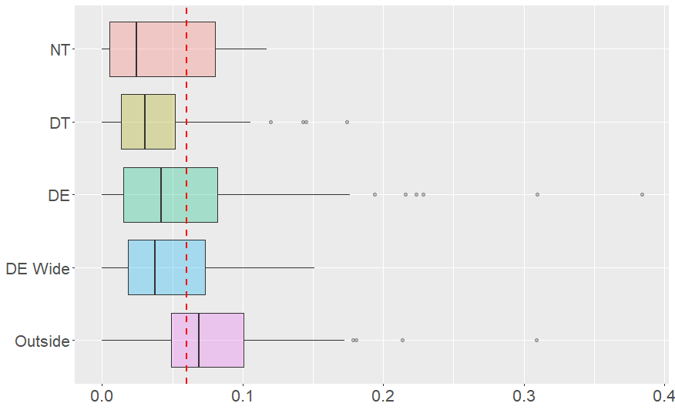
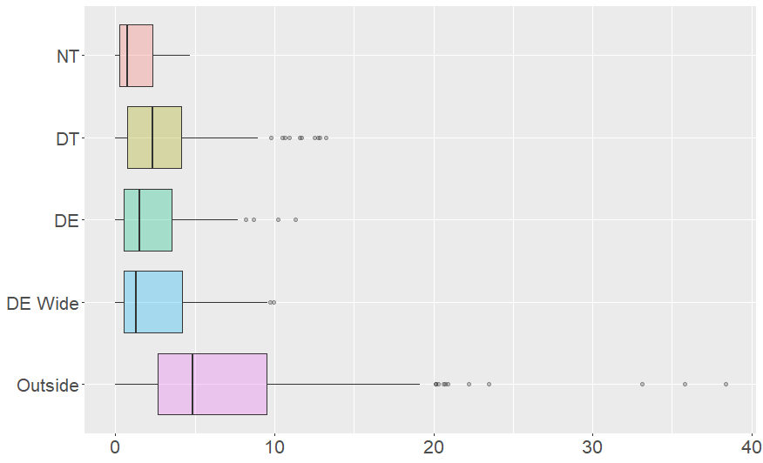
Distribution of talent by DL position?
Player performance on pass play: Impact on EPA by DL position
Impact on EPA by Player
Per Snap Basis
Players reviewed from both a total and per snap basis.
Totals are based on player’s snaps in technique group, so player could be listed multiple times (e.g. DE & Outside).
Assisted & solo sacks count equally.
Impact on EPA by Player
Total Basis
Only Outside DL average a higher EPA Impact per Snap than the DL average (red line).
Despite large number of snaps, DTs have relatively low Total EPA Impact due to a low EPA Impact per Snap.
Top 24 by Total EPAR are all Outside DL.
First non-Outside is Aaron Donald at #25.

Slide 31
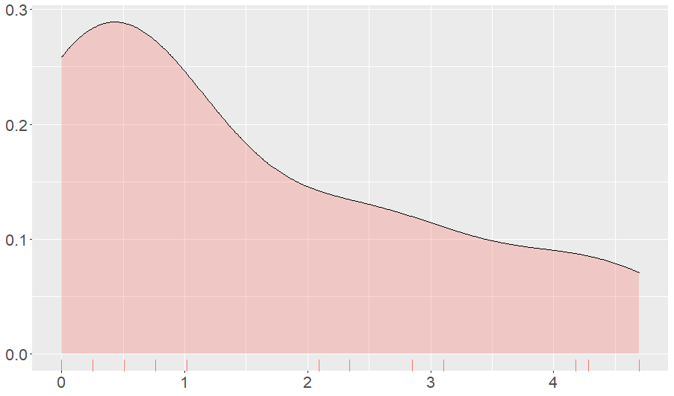
Distribution of talent by DL position?
Pass play by Impact on EPA: Nose Tackle (NT)
Top NT by Total EPA Impact
Adam Butler (4.7)
NT Tech Group averaged 35 pass rushing snaps in SIS Data
33% of eligible NTs had EPA Impact per snap over the DL average of 0.06 (7 out of 21)
Ifeadi Odenigbo – 0.12
Kenny Clark – 0.11
Adam Butler – 0.10
Fletcher Cox – 0.10
Davon Godchaux – 0.09
Nick Williams – 0.08
Vita Vea – 0.07
Nose Tackle
EPA Range Totals
Players must have at least 20 pass rushing snaps at NT Tech to be included

Slide 32
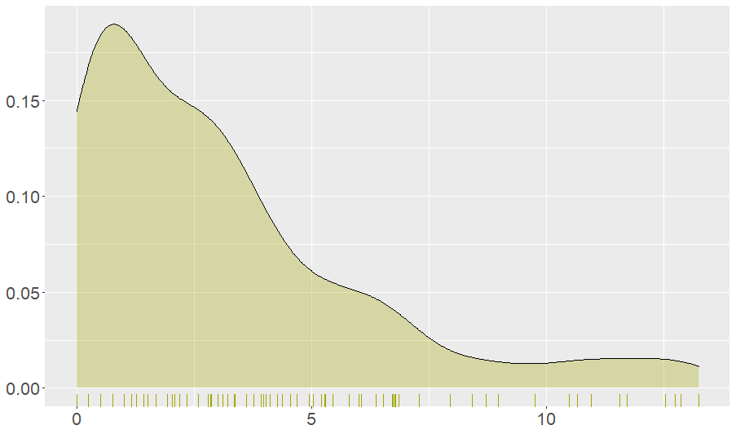
Distribution of talent by DL position?
Pass play by Impact on EPA: Defensive Tackle (DT)
Top DT by Total EPA Impact
Aaron Donald (13.2)
DT Tech Group averaged 80 pass rushing snaps in SIS Data
19% of eligible DTs had EPA Impact per snap over the DL average of 0.06 (30 out of 160)
Highest - Sam Hubbard – 0.17
10 out of the top 15 DTs by EPA Impact per snap have a Roster Position of DE.
The five DTs are Armon Watts, Chris Jones, Rodney Gunter, Danny Shelton, & Aaron Donald.
Defensive Tackle
EPA Range Totals
Players must have at least 20 pass rushing snaps at DT Tech to be included

Slide 33
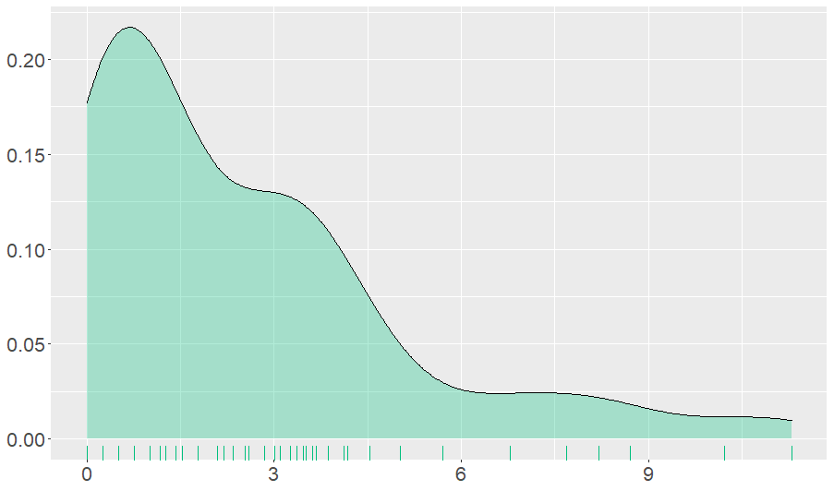
Distribution of talent by DL position?
Pass play by Impact on EPA: Defensive End (DE)
Only two DE with Total EPA Impact over 9.0
Chris Jones (11.3)
Dre’mont Jones (10.2)
DE Tech Group averaged 41 pass rushing snaps in SIS Data
36% of eligible DEs had EPA Impact per snap over the DL average of 0.06 (25 out of 69)
Highest – Jordan Jenkins – 0.38
2nd – Dre’mont Jones – 0.31
8 out of the top 11 DEs by EPA Impact per snap have a Roster Position of DT.
The other three are 2 DEs (Dre’mont Jones & Derek Wolfe) and a LB (Jordan Jenkins).
Defensive End
EPA Range Totals
Players must have at least 20 pass rushing snaps at DE Tech to be included

Slide 34
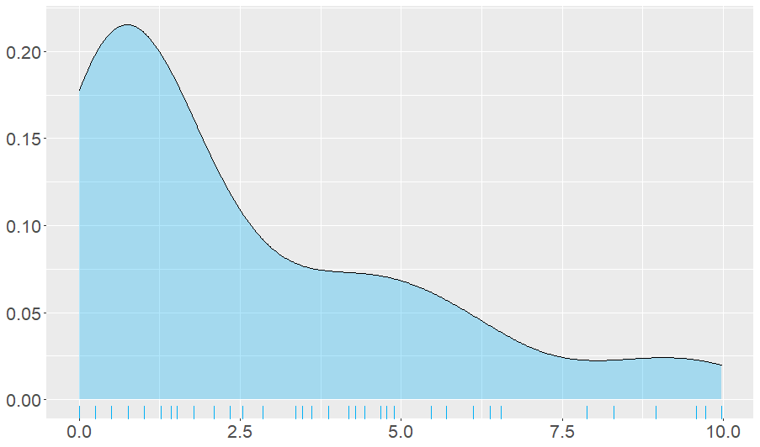
Distribution of talent by DL position?
Pass play by Impact on EPA: Defensive End Wide (DE Wide)
Top DE Wide players by Total EPA Impact
Trent Murphy (10.0)
Carlos Dunlap (9.7)
Danielle Hunter (9.6)
DE Wide Tech Group averaged 46 pass rushing snaps in SIS Data
36% of eligible DE Wide DL had EPA Impact per snap over the DL average of 0.06 (30 out of 77)
Highest – Jacob Martin (0.15)
2nd – Bruce Irvin (0.13)
Both Martin & Irvin have a Roster Position of LB.
DE Wide
EPA Range Totals
Players must have at least 20 pass rushing snaps at DE Wide Tech to be included

Slide 35
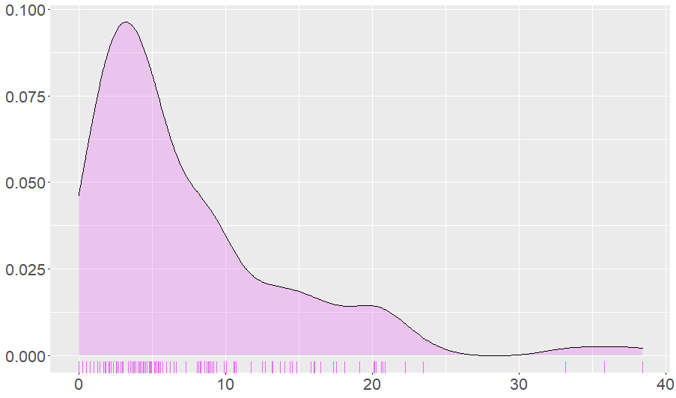
Distribution of talent by DL position?
Pass play by Impact on EPA: Outside
Top Outside by Total EPA Impact
Chandler Jones (38.4)
TJ Watt (35.8)
Shaq Barrett (33.1)
Bud Dupree (23.5)
Dante Fowler (22.2)
Outside Tech Group averaged 92 pass rushing snaps in SIS Data
51% of eligible NTs had EPA Impact per snap over the DL average of 0.06 (82 out of 160)
Highest – Jamal Adams (0.31; Roster - Safety)
2nd – Sam Acho (0.21)
Outside
EPA Range Totals
Players must have at least 20 pass rushing snaps at Outside DL Tech to be included

Slide 36
Distribution of talent by DL position?
Pass play by Impact on EPA: Outside (cont.)
Impact on EPA did not account for coverage other than interception events.
Outside Tech DL rushed on 90% of pass plays, meaning on average they dropped into coverage 10% of pass plays.
Value of coverage talent should be reviewed separately and considered for players who would be dropping into coverage often.
Five Outside Tech DL dropped into coverage at least 1/3 of the time:
Christian Jones – Pass Rush Rate = 46%
Jamie Collins – 54%
De’Vondre Cambell – 56%
Brandon Copeland – 61%
Tyus Bowser – 65%

Slide 37
Distribution of talent by DL position?
Talent measured by player performance: run plays
Impact on plays measured by reviewing the Expected Points Added (EPA) provided in the SIS data for each defensive snap.
Impact was reviewed based on run plays that the defender was “involved”.
Looking at a subset of plays that a player was “involved” enables us to attempt to filter out plays that the defender was not a factor.
A defender is deemed “involved” if:
The run play is designed for a gap that the defender is responsible for
or
The run play is NOT designed for a gap that the defender is responsible for, but the running back does NOT use the designed gap and the defender makes a play.

Slide 38
Distribution of talent by DL position?
Run Play: Defender Gap Responsibility
The first step in determining if a defender was involved is to determine if the run was designed for a gap for which the defender was responsible.
Middle
A Gap
B Gap
C Gap
D Gap
Outside
Notes:
Throughout the presentation, we will be referring to the Technique. As many of you know, the DL Technique describes the alignment of the DL relatively to the offensive line. Above is a graphical representation of those alignments.

Slide 39
Distribution of talent by DL position?
Run Play: Defender Gap Responsibility
Middle
A Gap
B Gap
C Gap
D Gap
Outside
0 and 1 Tech Defenders are responsible for Middle runs.
Notes:
Throughout the presentation, we will be referring to the Technique. As many of you know, the DL Technique describes the alignment of the DL relatively to the offensive line. Above is a graphical representation of those alignments.

Slide 40
Distribution of talent by DL position?
Run Play: Defender Gap Responsibility
Middle
A Gap
B Gap
C Gap
D Gap
Outside
0, 1, 2i, and 2 Tech Defenders are responsible for A Gap runs.
Notes:
Throughout the presentation, we will be referring to the Technique. As many of you know, the DL Technique describes the alignment of the DL relatively to the offensive line. Above is a graphical representation of those alignments.

Slide 41
Distribution of talent by DL position?
Run Play: Defender Gap Responsibility
Middle
A Gap
B Gap
C Gap
D Gap
Outside
2, 3, 4i, and 4 Tech Defenders are responsible for B Gap runs.
Notes:
Throughout the presentation, we will be referring to the Technique. As many of you know, the DL Technique describes the alignment of the DL relatively to the offensive line. Above is a graphical representation of those alignments.

Slide 42
Distribution of talent by DL position?
Run Play: Defender Gap Responsibility
Middle
A Gap
B Gap
C Gap
D Gap
Outside
4, 5, 7, and 6 Tech Defenders are responsible for C Gap runs.
Notes:
Throughout the presentation, we will be referring to the Technique. As many of you know, the DL Technique describes the alignment of the DL relatively to the offensive line. Above is a graphical representation of those alignments.

Slide 43
Distribution of talent by DL position?
Run Play: Defender Gap Responsibility
Middle
A Gap
B Gap
C Gap
D Gap
Outside
6, 9, and Outside Tech Defenders are responsible for D Gap runs.
Notes:
Throughout the presentation, we will be referring to the Technique. As many of you know, the DL Technique describes the alignment of the DL relatively to the offensive line. Above is a graphical representation of those alignments.

Slide 44
Distribution of talent by DL position?
Run Play: “Involved” Determination
Used Designed Gap
This field was provided in SIS data indicating if the running back used the designed gap or bounced the run to another location.
Play Made
This field is based on if the defender made either an Assisted Tackle or a Solo Tackle based on the SIS data.
Toward
Flag set based on approach described on prior slide.
Involved = Yes
These plays will be included in our analysis.
Involved = No
These plays will be excluded from our analysis since the defender was likely not primarily involved in the run play’s result.
EPA Greater Than Zero
These play will be included in our analysis if the EPA is less than or equal to zero. The defender should not be negatively impacted for making a play down the field on a run designed away from their alignment.
Run Play
Toward = True
Involved = Yes
Toward = False
Used Designed Gap = True
Used Designed Gap = False
Involved = No
Play Made = True
Play Made = False
Involved = No
Involved = No
EPA Greater Than Zero = True
EPA Greater Than Zero = False
Involved = Yes

Slide 45
Distribution of talent by DL position?
Run Play: EPA Determination
Run Play
Toward = True
Used Designed Gap = True
Toward = False
Used Designed Gap = True
Used Designed Gap = False
Excluded
Play Made = True
Play Made = False
EPA Greater Than Zero = True
Excluded
Used Designed Gap = False
EPA as provided
EPA with max of zero
Excluded
EPA Greater Than Zero = False
EPA as provided
EPA as provided
The EPA will be based on the data provided in the SIS data.
Excluded
These plays will be excluded from our analysis since the defender was likely not primarily involved in the run play’s result.
EPA with max of zero
A maximum of zero will be applied to the EPA. The defender likely plugged their gap causing the running back to change direction. The defender should not be negatively impacted for the rest of the defense losing containment.

Slide 46
Distribution of talent by DL position?
Player performance on run plays: “Involved” EPA by Player
Players reviewed from both a Total and Per Snap basis.
Totals are based on player’s snaps in Technique Group, so player could be listed multiple times (e.g. DE & Outside).
Only plays in which the defender is “involved” are included in the Total and the Per Snap determinations.
EPA data from SIS database converted to be from perspective of the defensive team.
i.e. Positive EPA indicates a strong defensive play.
Only players with at least 5 “involved” snaps were included in analysis.

Slide 47
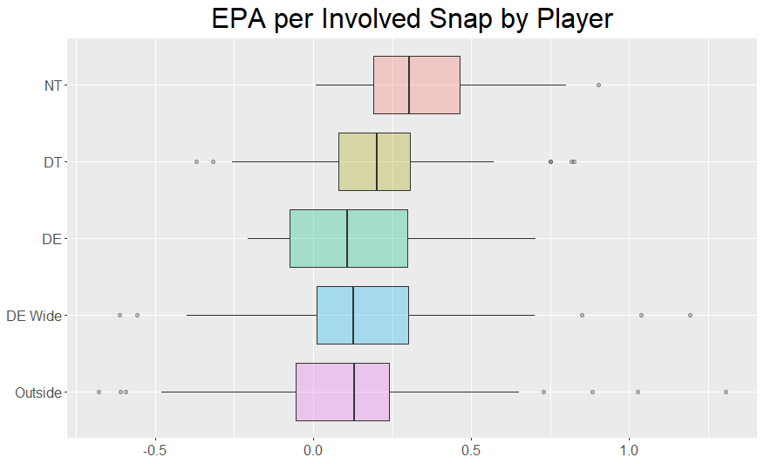
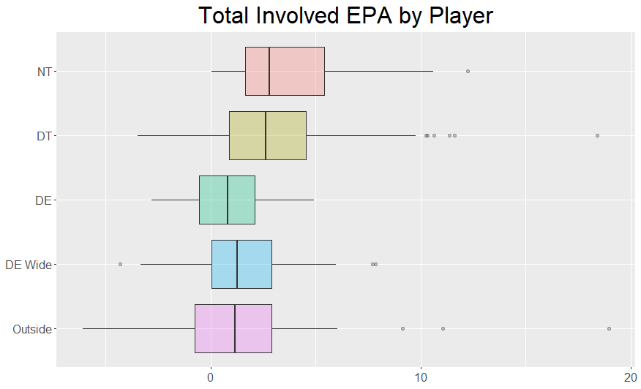
Distribution of talent by DL position?
Player performance on run plays: “Involved” EPA by Player
Over 76% of all defenders average a positive EPA on run plays for which they are “involved”. (259 out of 339)
NTs have the highest average EPA per Snap (0.355).
This is above the 75th percentile for all other DL positions.
Outside defenders have the lowest average EPA per Snap (0.10).
DTs have the 2nd highest average EPA per Snap and are tightly group with 50% of players between 0.08 & 0.31.
NTs and DTs have the 1st and 2nd highest average Total Involved EPA by Player (4.0 & 3.1 respectively).
Due to having 1st & 2nd highest EPA per Snap and 2nd & 1st highest number of “involved” snaps respectively.

Slide 48
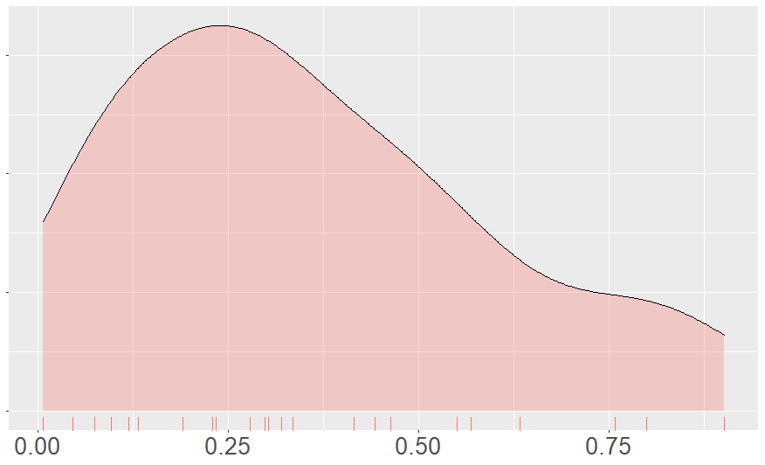
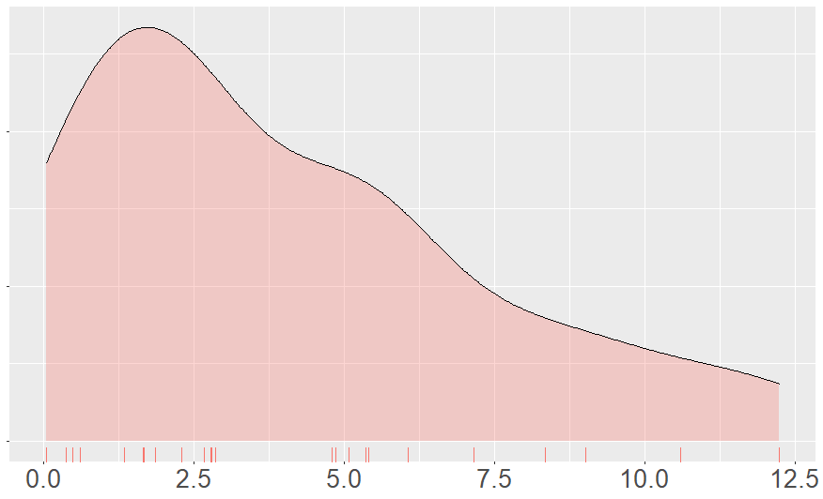
Distribution of talent by DL position?
Run Play by “Involved” EPA: Nose Tackle (NT)
Nose Tackle
EPA per Run Play
Nose Tackle
Total EPA for Run Plays
Highest average EPA per Snap – Steve McLendon (0.90)
2nd & 3rd – D.J. Jones (0.80) & Nick Williams (0.76)
All other were less than 0.64.
Zero NTs had a negative average EPA per Snap.
Highest Total EPA – Damon Harrison (12.2)
Primarily driven by 41 snaps at NT position.
Ranked 14th out of 25 on per Snap basis.
2nd Highest – Danny Shelton (10.5)
46 snaps at NT position; 17th on per Snap basis.
No other NT had over 26 snaps.
NTs averaged 12.2 “involved” snaps.

Slide 49
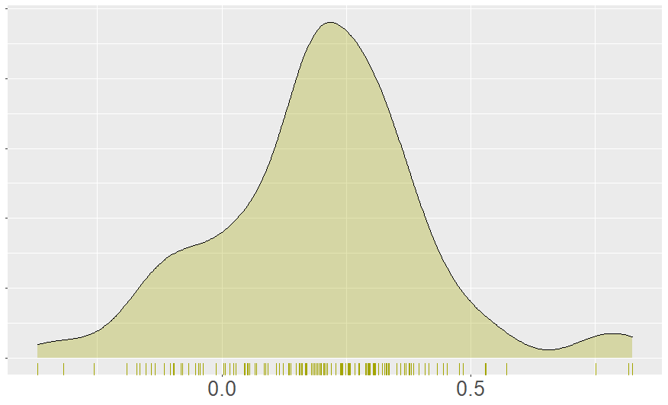
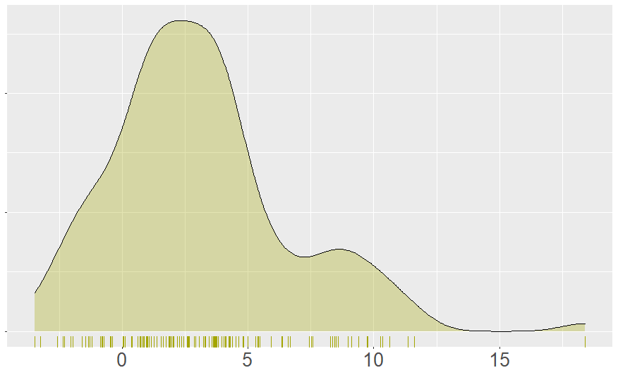
Distribution of talent by DL position?
Run Play by “Involved” EPA: Defensive Tackle (DT)
Defensive Tackle
EPA per Run Play
Defensive Tackle
Total EPA for Run Plays
Highest EPA per Snap – Adam Butler (0.82)
Three other DTs had EPA per Snap over 0.75 (William Gholston, Zach Kerr, & Matt Dickerson)
Large drop-off with fifth highest at 0.57.
49% of DTs average between 0.18 & 0.40 EPA per Snap (65 out of 132)
16% of DTs average below 0.0 EPA per Snap (21 out of 132)
Highest Total EPA – Dalvin Tomlinson (18.4)
Highest number of snaps at DT (38)
Large drop-off to 2nd – Grady Jarrett (11.6)
63% of DTs have Total EPA between 0 and 5 (0.5 per game)
DTs averaged 15.5 “involved” run plays.

Slide 50
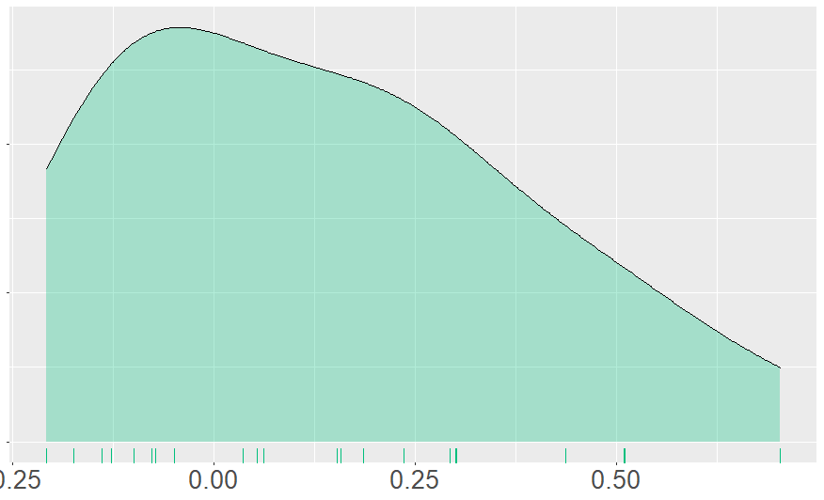
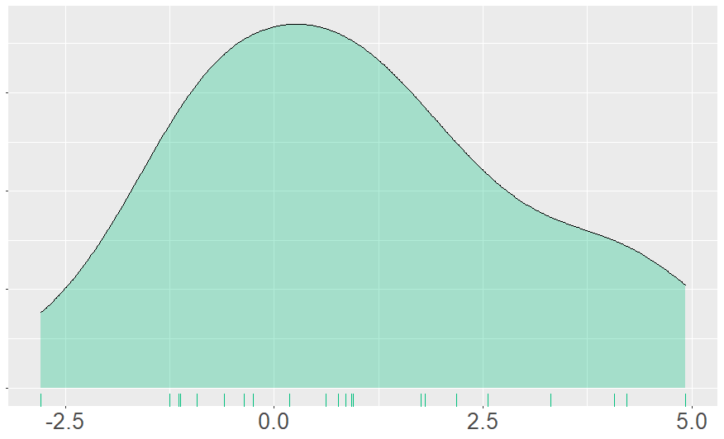
Distribution of talent by DL position?
Run Play by “Involved” EPA: Defensive End (DE)
Defensive End
EPA per Run Play
Defensive End
Total EPA for Run Plays
Highest EPA Impact per Snap – Chris Wormley (0.70)
All other were less than 0.51.
36% of DEs average below 0.0 EPA per Snap (8 out of 22)
No player averaged more than 0.5 Total EPA per game.
Highest Total EPA – Chris Wormley (4.9)
45% of DEs had a Total EPA between -1.0 and 1.0 (10 out of 22).
DEs averaged 8.1 “involved” run plays.

Slide 51
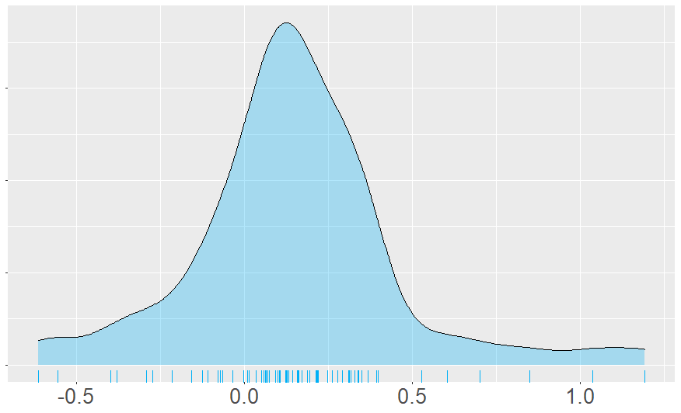
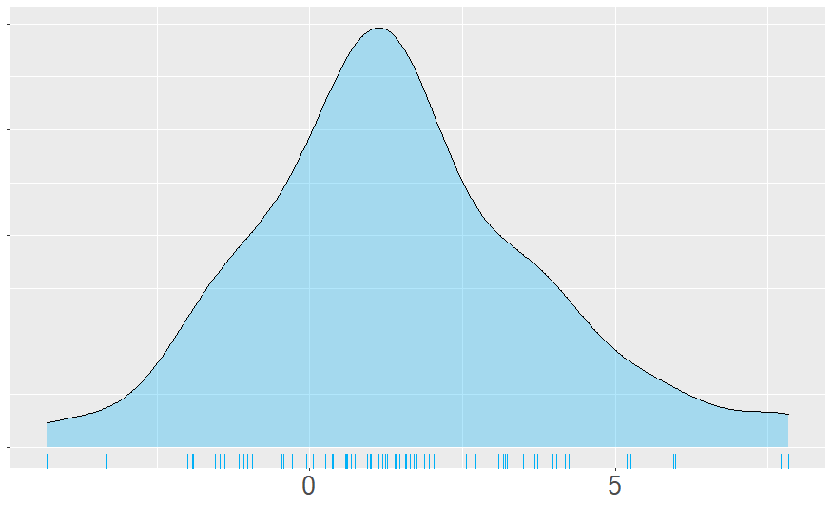
Distribution of talent by DL position?
Run Play by “Involved” EPA: Defensive End Wide (DE Wide):
DE Wide
EPA per Run Play
DE Wide
Total EPA for Run Plays
Highest EPA per Snap – Justin Houston (1.19)
Only 9% of DE Wide had EPA per Snap over 0.5 (6 out of 67).
67% of DE Wide had EPA per Snap between 0.0 and 0.4. (45 out of 67).
24% of DE Wide had EPA per Snap below 0.0 (16 out of 67).
Two had EPA per Snap below 0.5 (Josh Allen & Brandon Graham)
Highest Total EPA – Trent Murphy (7.8)
2nd highest – Calais Campbell (7.7)
No other players above 6.0.
48% of DE Wide had Total EPA between 0.0 and 2.0. (32 out of 67)
DE Wide defenders averaged 9.6 “involved” run plays.

Slide 52
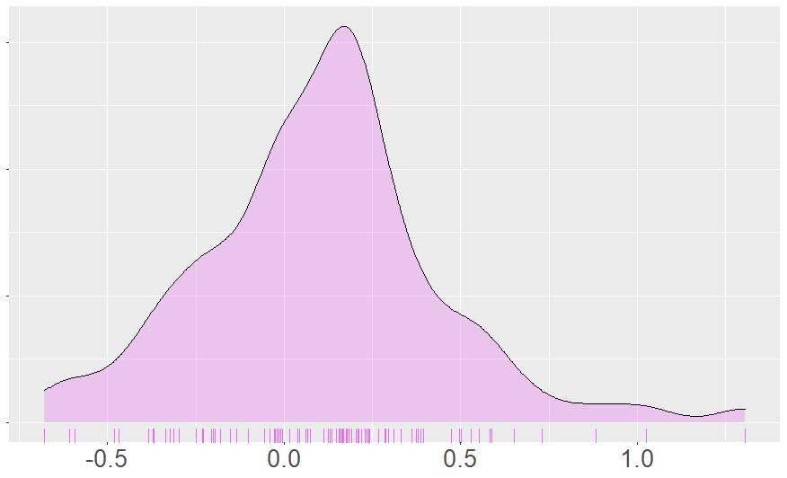
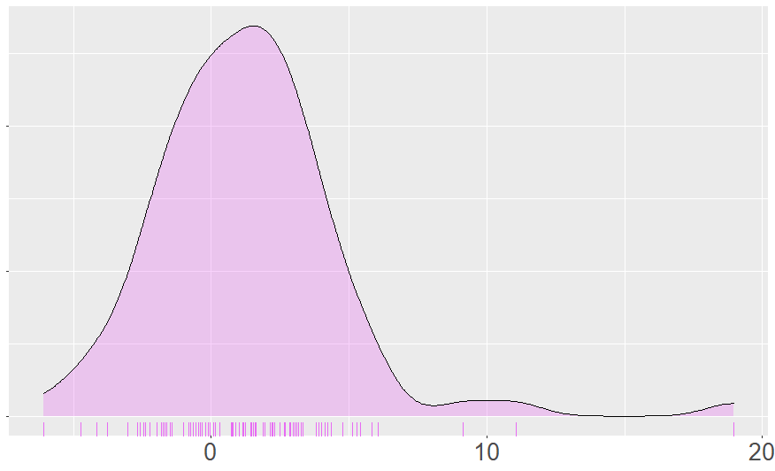
Distribution of talent by DL position?
Run Play by “Involved” EPA: Outside:
Outside
EPA per Run Play
Outside
Total EPA for Run Plays
Highest EPA per Snap – Eric Wilson (1.3); 2nd highest – Bruce Irvin (1.0)
11% of Outside defenders averaged over 0.5 EPA per Snap. (10 out of 93)
49% of Outside defenders averaged between 0.4 and 0.0 EPA per Snap (46 out of 93).
38% of Outside defenders averaged a negative EPA per Snap.
Three averaged below -0.5 (Bradley McDougald, Ezekiel Ansah, & Bryan Cox Jr.)
Highest Total EPA – Bud Dupree (19.0)
Highest number of snaps (26), but also 4th highest on per Snap basis.
2nd Highest – T.J. Watt (11.1)
No other Outside defenders had Total EPA over 10.
49% of Outside defenders had Total EP between 4.0 and 0.0. (46 out of 93)
Outside defenders averaged 10.6 “involved” run plays.

Slide 53
What scenarios would impact defensive line position value?
Win Probability of Defensive Team
While the Win Probability is already incorporated into the WPAR calculation, does the Defensive Team’s Win Probability impact the EPAR?
Base Defense of Defensive Team
Does a team’s Base Defense impact the Defensive Line position value?
Other Scenarios?

Slide 54
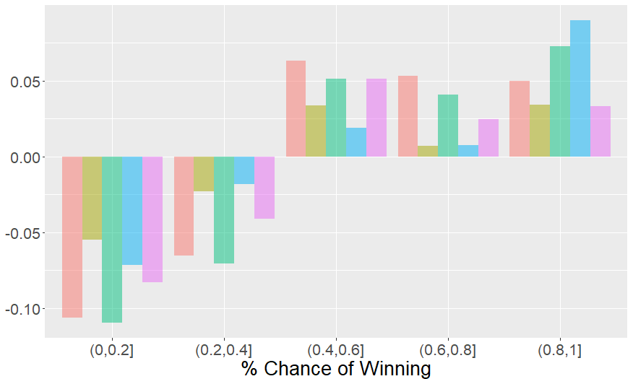
Most Valuable Defensive Line Position
Difference by Percent Change of Winning
As defensive team’s chance of winning increases, the EPA Range also increase.
However, the change in EPA Range is not uniform across defensive line positions.
% Chance of Winning & Impact Observed
0 – 20% Chance and 20 – 40% Chance
DL Positions still same rank, but smaller difference in EPAR by position
NT, DE, & Outside impacted more than DT & DE Wide causing gap to narrow in difference in EPAR by position.
40 – 60% Chance and 60 – 80% Chance
DL Positions still same rank, but larger difference in EPAR by position
NT, DE, & Outside impacted less than DT & DE Wide causing gap to spread in difference in EPAR by position.
80 – 100% Chance
Large increase in EPAR for DE & DE Wide.
DE remains 2nd in EPAR, but nearly equal to NT.
DE Wide becomes 4th and difference from other DL positions shrinks.
Position | Rank | Avg EPA Range | Avg WPA Range
NT | 1st | 1.13 | 0.037
DT | 4th | 0.97 | 0.030
DE | 2nd | 1.10 | 0.036
DE Wide | 5th | 0.95 | 0.029
Outside | 3rd | 1.07 | 0.034
Difference in EPA Range

Slide 55
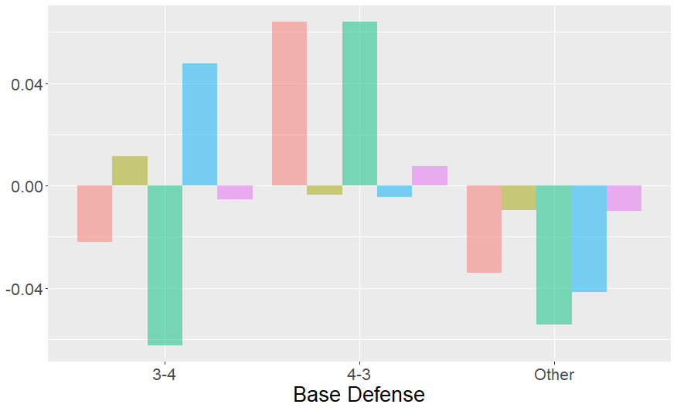
Most Valuable Defensive Line Position
Difference by Base Defense
Position | Rank | Avg EPA Range | Avg WPA Range
NT | 1st | 1.13 | 0.037
DT | 4th | 0.97 | 0.030
DE | 2nd | 1.10 | 0.036
DE Wide | 5th | 0.95 | 0.029
Outside | 3rd | 1.07 | 0.034
Difference in EPA Range
A defense’s Base Defensive package likely drives the frequency different techniques are used.
This would likely mean the EPA Range and “value” of the techniques is different based on a team’s Base Defense package.
The chart on the right shows there are clear differences for each Base Defense.
Each Base Defense will be analyzed further by comparing each DL position’s EPAR for the subset to the full population’s.
Base Defense information for 2019 was based on information from The IDP Guru.

Slide 56
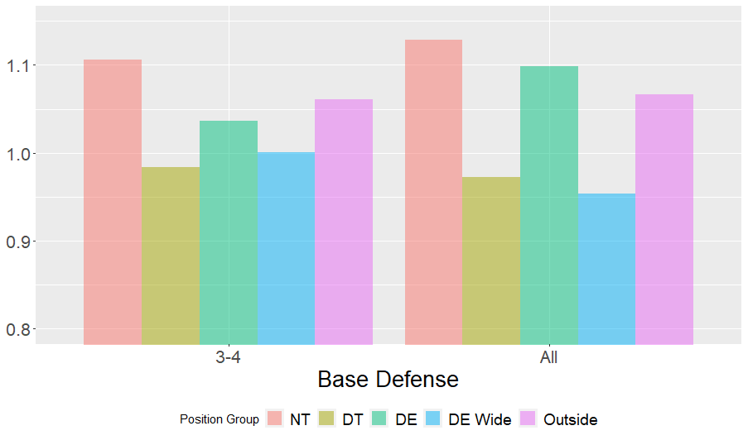
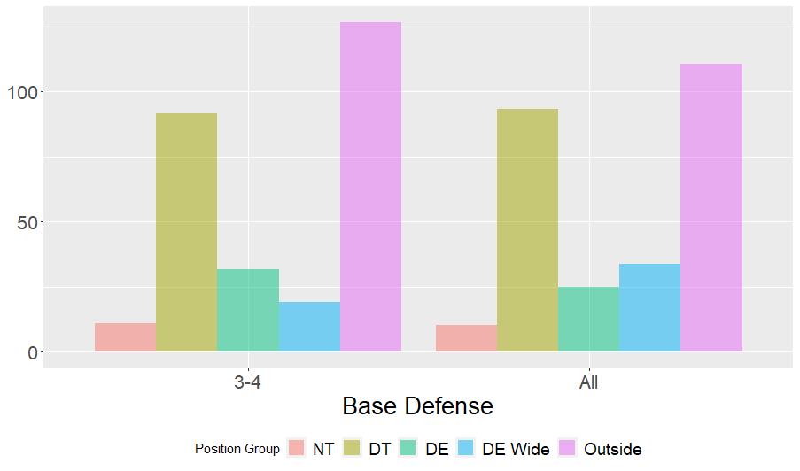
Most Valuable Defensive Line Position
Difference by Base Defense: 3-4 Defense
EPA Range per Snap
EPA Range Total per Game
On a per snap basis, the DT and DE Wide alignments are higher for the 3-4 than for the full league.
Generally these alignments aren’t frequently used in 3-4 defenses so it is possible the higher EPAR per snap is due to use on non-Base packages.
Standard 3-4 alignments (NT, DE) have a lower EPAR per snap than the full league.
The EPAR Total per game for DE Wide is significantly lower for 3-4 teams compared to the full league despite the higher EPAR per snap.
The EPAR Total per game for Outside is significantly higher for 3-4 teams compared to the full league.
This is likely due to the alignment of both outside linebackers on the line of scrimmage.

Slide 57
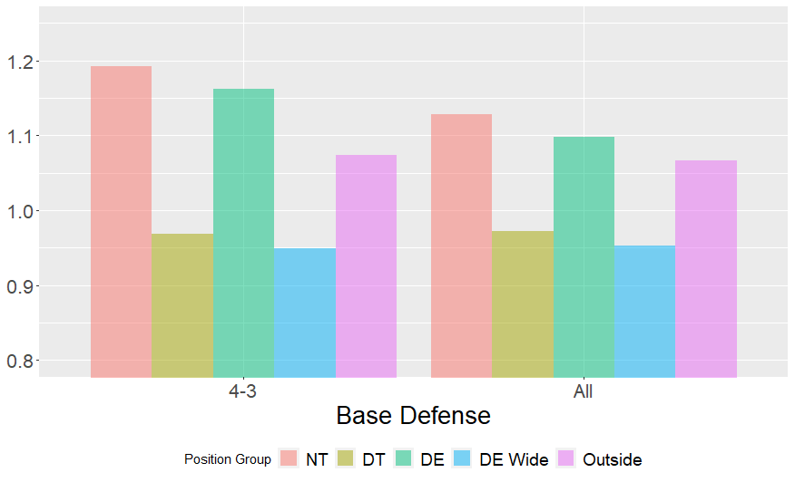
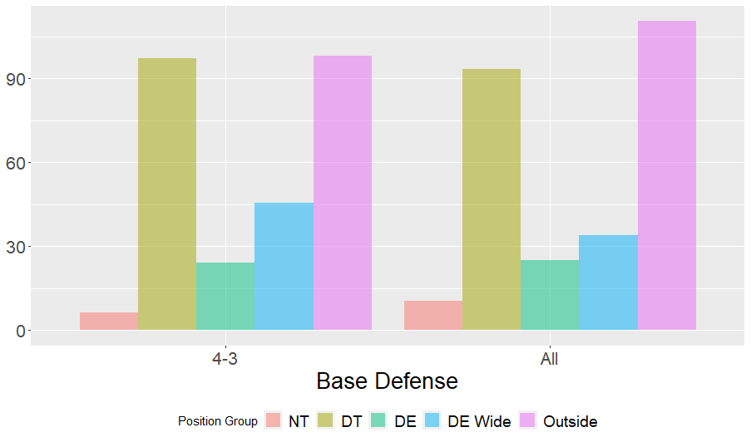
Most Valuable Defensive Line Position
Difference by Base Defense: 4-3 Defense
EPA Range Total per Game
EPA Range per Snap
Despite not having a NT in 4-3 Base package, the NT per snap EPAR is higher than average.
One possible explanation for this is that the NT is used in non-Base packages which occur on highly leveraged downs.
The same applies to the standard DE position.
The EPAR Total for NT is lower on a per game basis despite being higher on a per snap basis. This indicates 0/1-Techs are used less frequently for 4-3 Base Defensive teams than the overall average. This is consistent with 4-3 alignment.
The EPAR Total for DE is about equal for 4-3 and All despite the 4-3 having a higher per snap EPAR. Again, this is due to the lower frequency of DE use in 4-3 Base Defensive teams.
The DE Wide and Outside EPAR Totals are higher for 4-3 which is likely due to the alignment of the DE’s in a 4-3.

Slide 58


Most Valuable Defensive Line Position
Difference by Base Defense: Other Defense
EPA Range Total per Game
EPA Range per Snap
On a per snap basis, teams that do not have a standard Base Defensive package have a similar value distribution by DL position to the full league.
This may be due to a use of a wider range of defensive alignments.
The NT and DE positions appear to have a lower EPAR per snap than the league average.
For NTs, despite having a lower EPAR per snap, the EPAR Total is higher for the Other group than for the league average
For DEs, however, the EPAR on both a per snap and per game basis is lower for this group than the league average.
For Outside DLs, the EPAR Total is significantly higher for these teams than the league average.

Slide 59
Most Valuable Defensive Line Position
Difference by Base Defense: Summary
Conclusions
It appears that for a given base defense, the standard technique alignment have a lower EPAR on a per snap basis, but due to the larger number of snaps, have a higher EPAR Total compare to the league average.
This is possibly due to the use of the Base Defense package on standard plays which have lower EPAR.
On the other side of this, it appears that non-standard technique alignments have a higher EPAR on a per snap basis than league average, but due to low frequency have a lower EPAR Total.
Similarly, this is possibly due to the use of non-Base Defense packages for highly leveraged downs with higher EPAR.

Slide 60
Most Valuable Defensive Line Position
Other Scenarios?
Opponent offense type
The opponent’s offense type (e.g. pass heavy) may lead to certain DL positions being more valuable.
Weather
The weather may lead to certain DL positions being more valuable.
This could be driven based on the higher use of certain defensive packages / alignment to counter the offensive scheme.
Inclement weather may limit the offensive options which could lead to a different selection of defensive packages for certain game situations.

Slide 61
Limitations & Future Analysis
Defensive lineman position valuation
Changes in defensive scheme
Since the DL position valuation is driven by the opportunities given the defensive players, any change in defensive scheme or alignment usage would change the valuation of a given DL position.
Players aligning in multiple techniques
As we saw during the position analysis, may players align in a wide range of techniques, so determining a valuation based on technique makes it difficult to value players.
A team would have to determine how they would intend to use the player in order to approximate an appropriate valuation.

Slide 62
Limitations & Future Analysis
Talent evaluation
Event driven evaluation
For pass plays, the talent level was determined based on event occurrence. However, a player may be significantly involved in a play despite not actually recording the event. This can lead to under-valuation of certain players and overvaluation of other.
Players aligning in multiple techniques
Again, players align in multiple techniques so their values is really a composite of the talent evaluation performed at each DL position.
For run plays, the contribution to the results of a play are extremely complex. The approach used may do a good job isolating when a player is directly involved, but it does not capture plays well when they are indirectly involved.
Additionally, for run plays, the analysis measures successful plays well, but may not measure poor defensive performances well. This is apparent based on the generally positive results.

